Slide 1
Endangered Species Analysis in National Parks
Biodiversity Insights from NPS Data
Spencer Wilkins
Feb 16, 2026

Slide 2
Project Overview
Role: Biodiversity Analyst for National Park Service
Objective: Objective: Analyze at-risk species and observation patterns to support NPS biodiversity monitoring
Key Questions:
  Distribution of conservation status across species
  Are certain species/categories more likely to be protected/endangered?
  Are category differences in protection statistically significant?
  Which species are most commonly observed and how do sightings vary by park?
Approach: Data cleaning, descriptive stats, visualizations, chi-square inference
Datasets: species_info.csv (species details) + observations.csv (park sightings)

Slide 3
Data Description
Two primary datasets: from Codecademy (inspired by real NPS data, mostly fictional)
species_info.csv — Species-level details (5,824 rows)
  Key columns: category, scientific_name, common_names, conservation_status
observations.csv — 7-day sighting counts per species per park (23,296 rows)
  Key columns: scientific_name, park_name, observations
Merged into one working table (df) on scientific_name for combined analysis
Total unique species: ~5,541
Parks: 4 (Great Smoky Mountains, Yosemite, Bryce, Yellowstone)
Observation range: 9 to 321 per record (mean ~142)

Slide 4
Data Reference Table
Dataset | Rows | Key Columns | Purpose
species_info.csv | 5,824 | category, scientific_name, conservation_status | Species characteristics & status
observations.csv | 23,296 | park_name, observations | Sighting counts by park
Merged (df) | 23,296 | All above | Combined park + species analysis

Slide 5
Conservation Status Overview
“Protected species” (Species not listed as NaN):
  Species of Concern: dominant category (161 species)
  Endangered: 16 species
  Threatened: 10 species
  In Recovery: 4 species
Most species (~97%) have no listed conservation status (NaN / Not Listed)
Chart to follow:

Slide 6
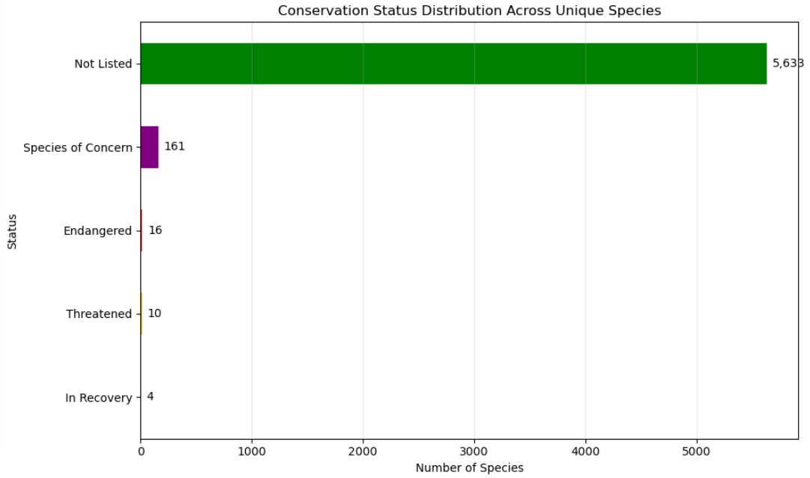

Slide 7
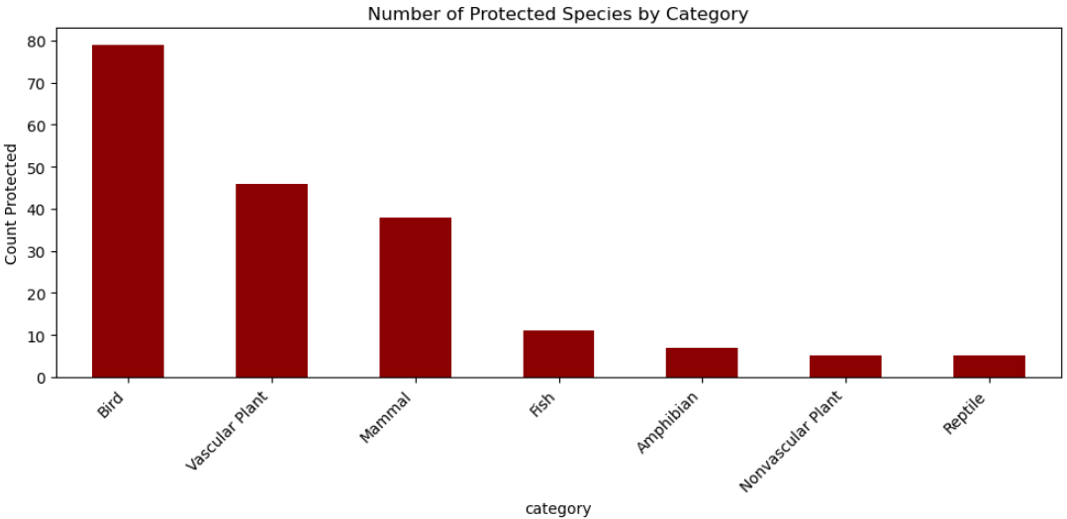
Protected Species by Category
Mammals and birds have the highest rates of protected status
Mammals: ~18% protected (38 / 214 total)
Birds: 15.3% protected. (79 / 521)

Slide 8
Observations, Volumes & Trends
Observation counts are varied: Most species have low total sightings.
Protected species tend to have lower average observations than non-protected ones
Certain categories dominate sightings (Ex: vascular plants and birds in high numbers)
Park differences exist (e.g., Yellowstone often reports higher averages across categories)
Most species are rarely observed, creating varied distributions across categories.
  Protected species appear less common in sightings — this could reflect real rarity, monitoring gaps, data collection bias, or behavioral differences.
  Ex: plants are stationary, amphibians easier to spot in water, mammals/birds harder to detect.

Slide 9
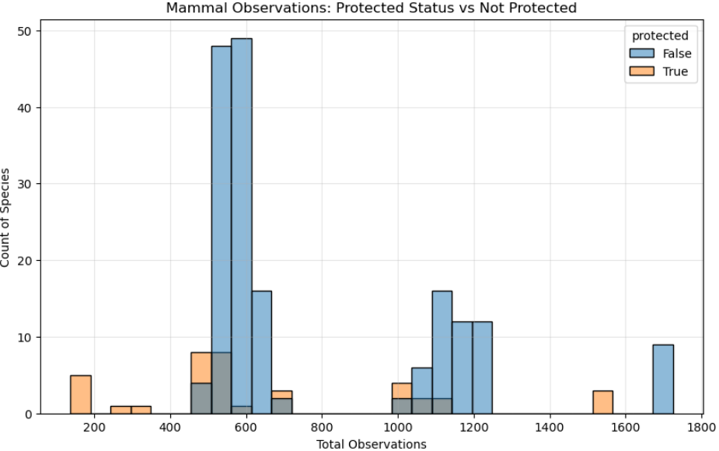

Slide 10
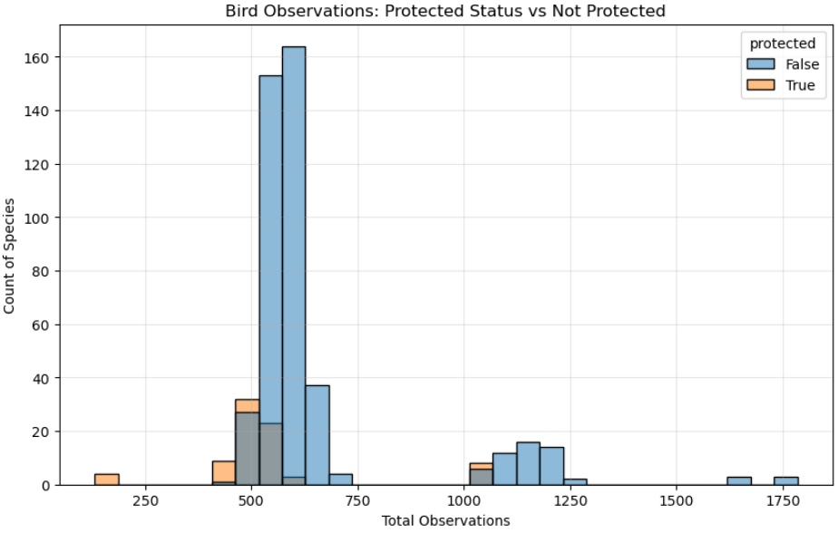

Slide 11
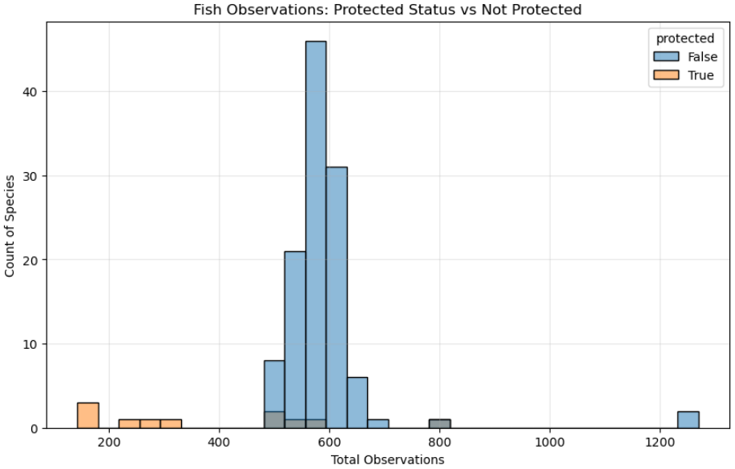

Slide 12
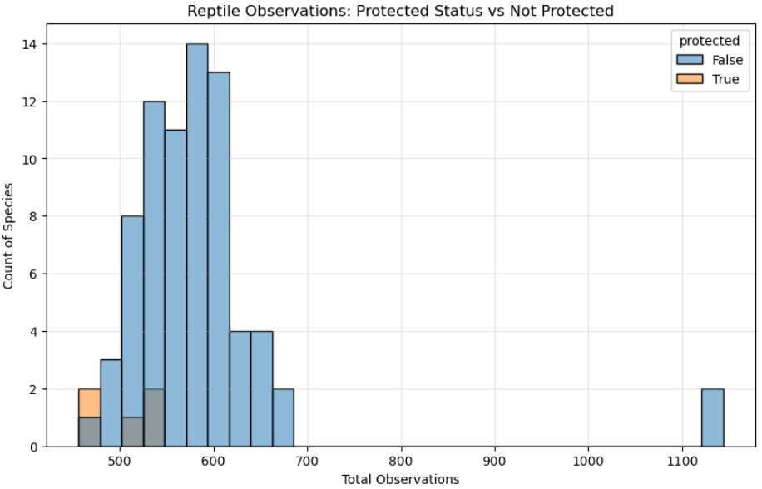

Slide 13
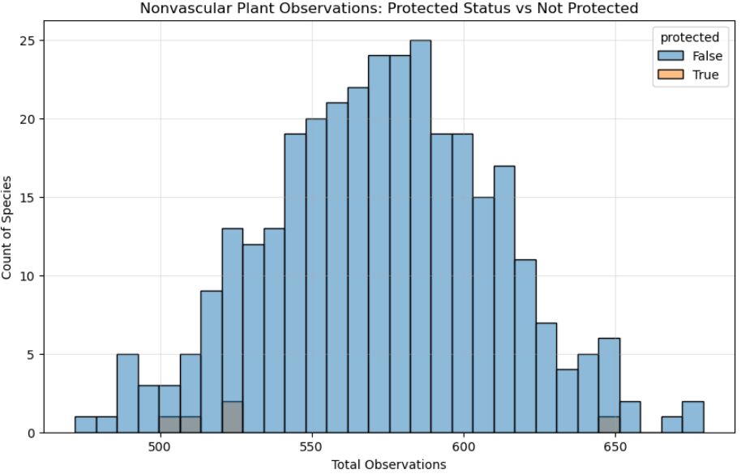

Slide 14
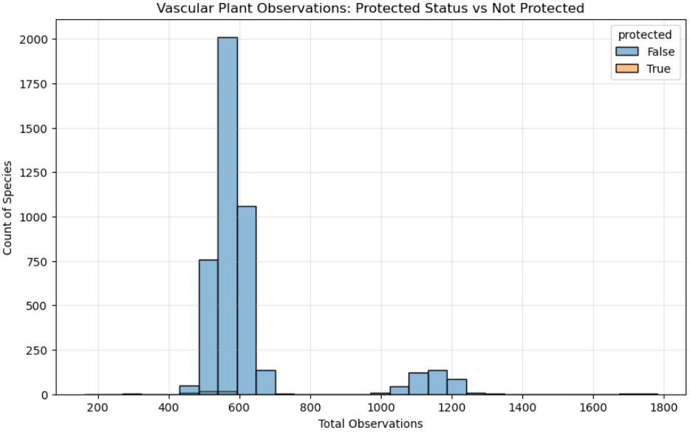

Slide 15
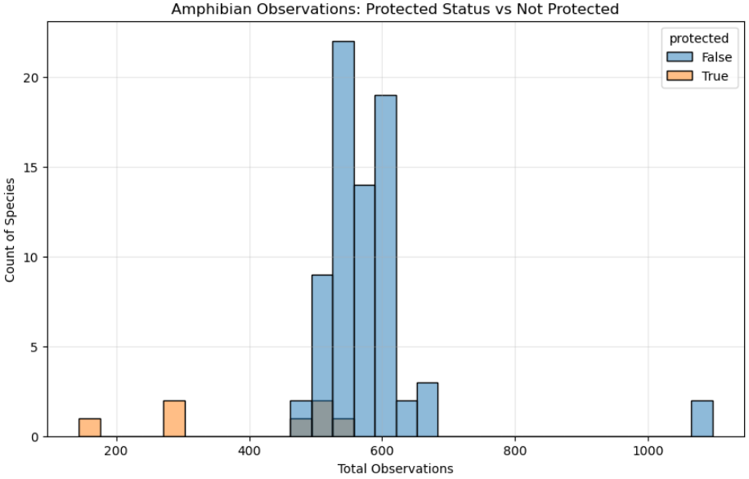

Slide 16
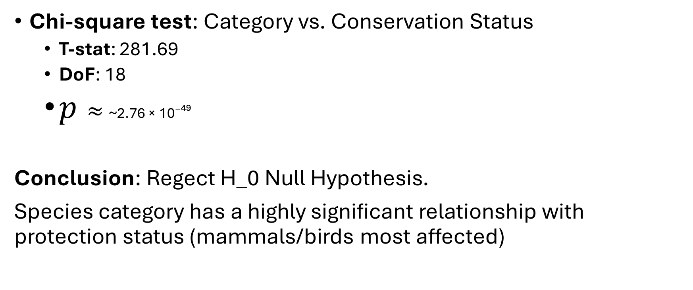
Statistical Insights of Category Differences
Chi-square test: Category vs. Conservation Status
  T-stat: 281.69
  DoF: 18
  $p≈$~2.76 × 10⁻⁴⁹
Conclusion: Regect H_0 Null Hypothesis.
Species category has a highly significant relationship with protection status (mammals/birds most affected)

Slide 17
Takeaways & Recommendations
This analysis examined biodiversity data from the National Park Service to understand species conservation status, endangerment patterns, and observation trends.
Key findings:
  Most species are not listed as protected (conservation_status = NaN / "Not Listed").
  Among the protected minority, "Species of Concern" is the most common status.
  Certain categories are significantly more likely to be protected: mammals and birds show noticeably higher proportions of protected species compared to vascular plants, nonvascular plants, reptiles, fish, and amphibians.
  Observation volume is highly skewed: Most species have low total observations, with a long tail of commonly sighted ones. Protected species tend to have lower average observations overall, possibly due to smaller populations or monitoring challenges.
These results were expected in broad strokes (mammals/birds more protected due to visibility and known threats).
Limitations:
  The data is fictional.
  Conceptually, a weeks worth of observations does not seem robust enough to make a conclusion on whether a species is thriving or not.
Overall, the analysis supports the hypothesis that species category carries an inherent conservation risk.

Slide 18
The End.

